Slide 1
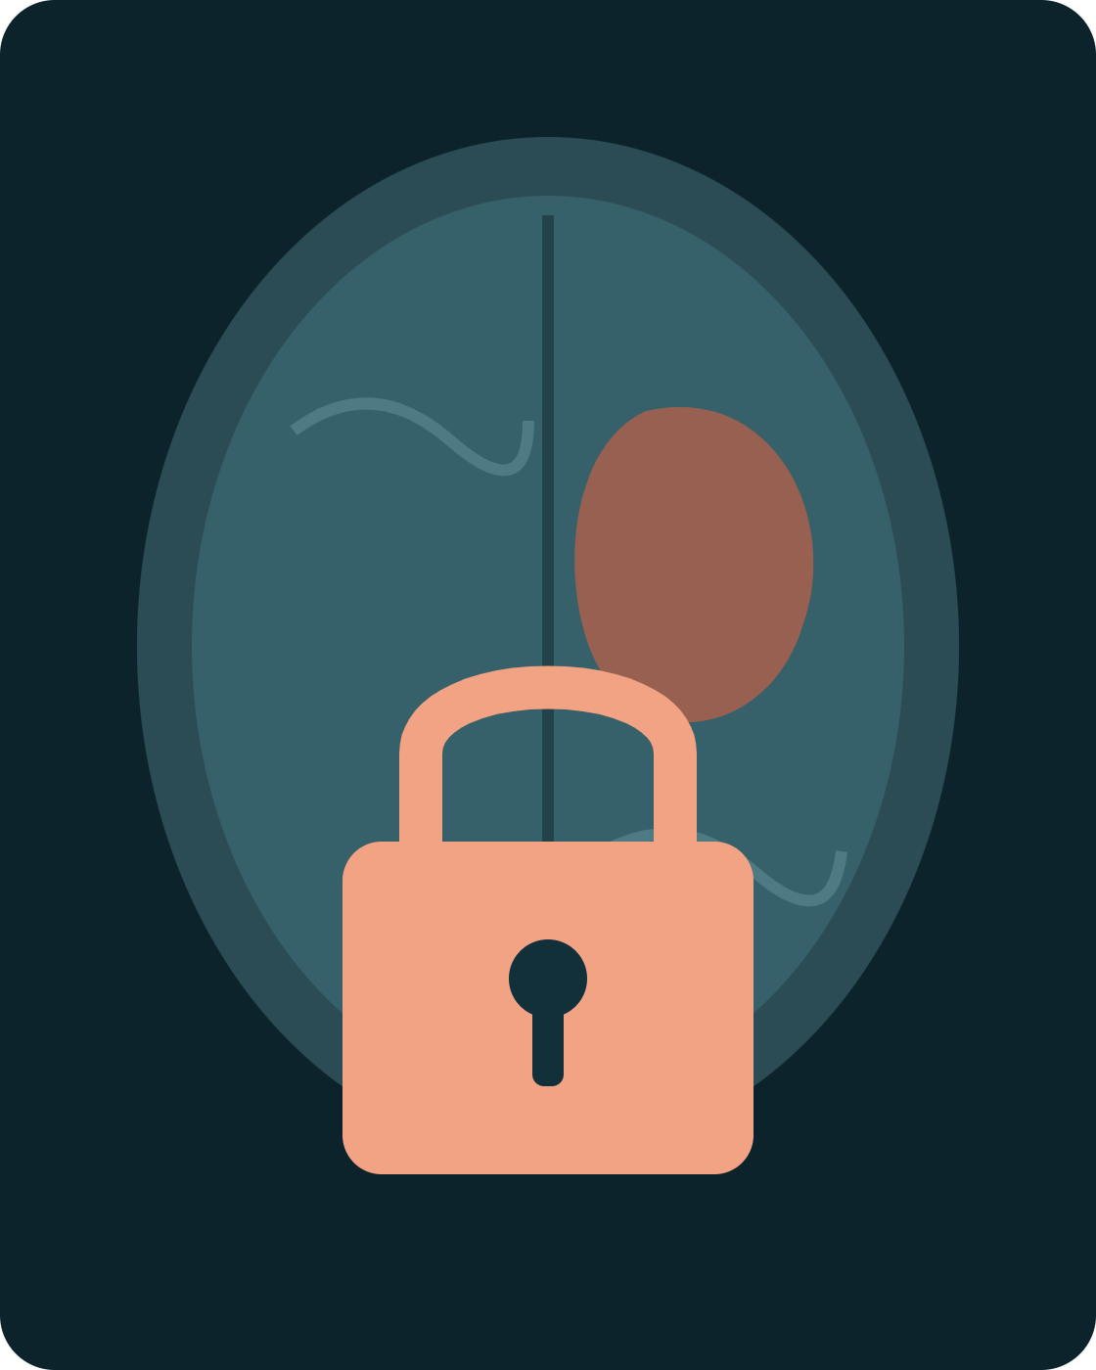
CSEG3060 · RESEARCH METHODOLOGY IN COMPUTER SCIENCE
UNIT III · PART 3
Research Ethics & Data Privacy
Doing honest research with patient data, continuing with brain tumour segmentation in MRI.
Dr. Mohsin Furkh Dar · School of Computer Science, UPES
Notes:
Priya now has a gap: a segmentation model that copes with missing MRI sequences, tested on scans from Indian hospitals. That means real patient data. Today is about handling it honestly and legally.

Slide 2
SESSION GOALS
By the end of this session, you can…
01
Apply honesty, objectivity and integrity to a machine learning study
02
Spot the hidden identifiers in medical images
03
Compare GDPR, HIPAA and India’s DPDP Act
04
Explain the role of the IRB / Institutional Ethics Committee
05
Lay out the correct procedure before, during and after data collection
CSEG3060 · Unit III · Part 3 — Research Ethics & Data Privacy

Slide 3
WHY ETHICS COMES FIRST
An MRI scan is not just an image. It belongs to a patient.
A diagnosis
An identity
A trust
A brain tumour is some of the most sensitive health information a person has.
Files carry names, IDs and dates, and a 3D head scan contains a face.
Patients were scanned for care, not for your thesis. Reuse needs permission.
Notes:
Open with a question: would you be comfortable if your own brain scan, with your name on it, appeared in a student's GitHub repository? Hold that thought for the case study later.

Slide 4
A · CORE PRINCIPLES
Three principles, made concrete for segmentation
Principle | Meaning | Violation | Correct practice
Honesty | Report what actually happened | Tuning on the test set, then reporting that Dice | Separate validation set; touch the test set once
Honesty |  | Reporting only the best of ten runs | Report mean ± standard deviation
Objectivity | Let evidence, not hope, decide | Showing only the neatest tumour outlines | Include failure cases and per-region scores
Objectivity |  | Tuning your model but not the baselines | Give baselines the same tuning effort
Integrity | Keep your word, respect the rules | Using BraTS without its terms or citations | Follow data-use terms; cite the datasets
CSEG3060 · Unit III · Part 3 — Research Ethics & Data Privacy

Slide 5
A · HONESTY IN PRACTICE
The quiet cheat: data leakage between patients
✗ Split by slice
✓ Split by patient
Train
P1
P2
P1
P3
P2
Train
P1
P1
P2
P2
Test
P1
P3
Test
P3
P3
Neighbouring slices of the same patient look almost identical. The model is tested on brains it has already seen, so Dice looks better than it really is.
Every scan of a patient goes to exactly one set. The test score now measures performance on genuinely new patients.
Reporting leaked results as real is an honesty failure. Check your split.
CSEG3060 · Unit III · Part 3 — Research Ethics & Data Privacy
Notes:
P1, P2, P3 are three patients; each chip is one 2D slice. This is one of the most common problems in medical imaging papers, because 2D models make it easy to shuffle slices without thinking about patients.

Slide 6
B · DATA PRIVACY
Three places a scan hides a patient’s identity
1
2
3
The file header
The face
The pixels
DICOM headers store name, patient ID, birth date, scan date and hospital.
A 3D head MRI can be rendered into a face. A 2019 study in NEJM matched such reconstructions to photos with face-recognition software.
Some images have names or dates burned into the pixels; a rare condition in a small town can identify someone alone.
Fix: strip or replace every identifying tag
Fix: “deface” volumes before sharing
Fix: inspect images; limit rare details
Face study: Schwarz et al., New England Journal of Medicine, 2019
Notes:
Renaming the file to patient_001.nii is not anonymisation. Ask students which of the three leaks the GitHub case study later on would have contained.

Slide 7
B · DATA PRIVACY
Pseudonymised is not the same as anonymised
Pseudonymised
Anonymised
Ravi Kumar → PT-0417
Ravi Kumar → (no link exists)
Names replaced by codes, but a key file can link them back.
No reasonable way to identify the person, even by combining it with other data.
Still personal data. Keep the key locked and separate, and protect the data as personal data.
Hard to achieve for images; needs header cleaning, defacing and removing rare details.
Under GDPR, pseudonymised data is still personal data; only truly anonymised data falls outside the law.
CSEG3060 · Unit III · Part 3 — Research Ethics & Data Privacy
Notes:
"Ravi Kumar" is a made-up name. In practice, Priya's project will almost certainly work with pseudonymised data inside the hospital and should only ever share anonymised data outside it.

Slide 8
C · PRIVACY LAWS
Which privacy law applies to you?
 | GDPR (EU, 2018) | HIPAA (USA, 1996) | DPDP Act (India, 2023)
Covers | Personal data of people in the EU | US health providers, insurers and partners | Digital personal data processed in India
Health data | A “special category” needing extra justification | Protected Health Information (PHI) | Personal data; no separate sensitive tier
De-identify by | True anonymisation | Safe Harbor: remove 18 identifier types | Consent and purpose limits for identifiable data
For Your work | Only if EU data or partners | Only if US hospital data | Applies directly
BraTS itself was assembled across institutions, so always read a dataset’s own terms as well as the law.
CSEG3060 · Unit III · Part 3 — Research Ethics & Data Privacy · Summary only, not legal advice
Notes:
Keep this at the level of principles. Students do not need the article numbers; they need to know which law is triggered by which data, and that India's DPDP Act is the one for Indian hospital scans.

Slide 9
C · PRIVACY LAWS
India’s DPDP Act in your terms
Data Principal
Data Fiduciary
Consent
The patient whose scan it is.
Whoever decides why and how the data is used: the hospital, the university.
Free, specific, informed and unambiguous, for a stated purpose.
Purpose limitation
Rights
Children
Scans shared for tumour research cannot quietly be reused for something else.
Access, correction and erasure; consent can be withdrawn.
Under 18 needs verifiable parental consent: relevant for paediatric tumours.
The Act allows some processing for research under conditions and prescribed standards. Your ethics committee, not you, decides how that applies.
Digital Personal Data Protection Act, 2023 · Summary for teaching, not legal advice

Slide 10
D · ETHICS REVIEW
The IRB checks your plan before any data moves
An Institutional Review Board, called an Institutional Ethics Committee (IEC) in India, reviews research involving people or their data. Indian IECs follow the ICMR National Ethical Guidelines (2017).
What the committee reviews
Purpose and scientific value
Risks to patients, and how they are reduced
Consent form, or case for a waiver
De-identification and storage plan
Who can access the data, and for how long
Plans for publishing and sharing
Approval comes first. Collecting data and asking later is a violation, however good the intentions.
Using old, stored scans? The committee may allow a waiver of consent. The committee decides that, not the researcher.
CSEG3060 · Unit III · Part 3 — Research Ethics & Data Privacy
Notes:
Ask: does training on the public BraTS dataset need IEC approval? Usually the data-use terms are the main requirement, but some institutions still ask for a formal exemption. Collecting new scans from a hospital definitely needs approval, from the hospital's committee and often the university's too.

Slide 11
E · CASE STUDY 3, ADAPTED
The “reproducible” GitHub repository
A PhD student building a brain tumour segmentation model finds a hospital server that is openly accessible. They download MRI scans with radiology reports. To make the work “reproducible”, they upload the full dataset to a public GitHub repository, with patient names still in the file headers.
Discuss in pairs (5 min):
Which principles were broken? Which laws apply? What should the student have done instead?
Notes:
Give pairs five minutes before revealing the next slide. Most students spot the names; fewer notice that "openly accessible" does not mean "permitted", or that the faces in 3D scans and the radiology reports are also identifying.

Slide 12
E · CASE STUDY: WHAT WENT WRONG
Five failures in one repository
What the student did | What it violated | Why it matters
Took data from an open server | Integrity; hospital’s ownership | Accessible is not the same as permitted
No ethics approval | IEC review; ICMR guidelines | No one checked risks or safeguards
No consent or waiver | Informed consent; DPDP Act | Patients never agreed to this use
Left names, reports, faces | De-identification; DPDP Act (HIPAA if US data) | Diagnoses now linked to real people
Posted on public GitHub | Purpose limitation; security safeguards | Copies spread; it cannot be undone
Reproducibility never overrides privacy.
CSEG3060 · Unit III · Part 3 — Research Ethics & Data Privacy

Slide 13
E · THE CORRECT PROCEDURE
Your checklist: before, during, after
Before collection
During collection
After / publication
Written agreement with the hospital
IEC approval of the protocol
Consent form, or approved waiver
Data management plan
Parental consent for under-18s
De-identify inside the hospital
Deface 3D volumes
Store encrypted on approved servers
Keep the ID key separate
Log who accesses the data
Share code, not raw scans
Report results on BraTS too
Release only approved data
Report failures and subgroups
Delete data as promised
CSEG3060 · Unit III · Part 3 — Research Ethics & Data Privacy
Notes:
Reporting on BraTS as well as private hospital data gives other researchers a public benchmark to reproduce against, which answers the "reproducibility" argument from the case study without exposing any patient.

Slide 14
E · DOING IT RIGHT
Reproducible research without exposing patients
Share the code and settings
Benchmark on public data
Training scripts, pre-processing steps, hyperparameters and random seeds.
Report BraTS results too, so anyone can compare without your private scans.
Use controlled access
Treat model weights with care
Release approved, de-identified data through repositories that require a data-use agreement.
Models can memorise training data. Ask the committee before releasing weights trained on private scans.
CSEG3060 · Unit III · Part 3 — Research Ethics & Data Privacy
Notes:
The Cancer Imaging Archive (TCIA) is a well-known example of a controlled repository for de-identified medical images; some of its collections require signed data-use agreements.

Slide 15
TRY IT · 20 MINUTES
What would you do? Three dilemmas
A · The shortcut
B · The awkward result
C · The offer
A relative who is a radiologist offers to send you 200 scans on WhatsApp, “to save time”.
The model scores much lower on children’s tumours. A co-author suggests leaving that table out.
A start-up offers to buy the de-identified hospital dataset you assembled for your thesis.
For each: which principle or law is at stake, and what is the right action?
Notes:
Expected answers. A: no approval, no agreement, insecure channel; decline and go through the IEC and the hospital. B: objectivity and honesty; report the subgroup result and discuss it as a limitation. C: purpose limitation and the terms of the approval; the data was released for her research only, so it is not hers to sell.

Slide 16
KEY TAKEAWAYS
Four rules for research with patient data
1
Honest results start with an honest split: divide by patient.
2
Headers, faces and pixels can all identify a patient.
3
For Indian hospital data, the DPDP Act applies; approval comes before collection.
4
Reproducibility never overrides privacy: share code and benchmarks, not patients.
Next · Part 4: Plagiarism and citation ethics, writing it all up honestly

